Slide 1
Session 3
Communication and Language Assistance
CLAS Training [ADD DATE}
[ADD PRESENTER NAME]
[ADD ORGANIZATION NAME]

Slide 2
Welcome
Review
Principal Standard: Provide effective, equitable, understandable, and respectful quality care and services that are responsive to diverse cultural health beliefs and practices, preferred languages, health literacy, and other communication needs.

Slide 3
Learning objectives
List two barriers that LEP populations experience in accessing services
List three benefits for ensuring competence for translation and interpretation
Explain why it is important to consider culture in communication and language assistance

Slide 4
The context
Activity
Cross-cultural communication activity
Discussion
What did you learn from this activity?
Can you think of a time when culture influenced your communication with someone?
How does this relate to your patients, customers, client’s need for language assistance?

Slide 5
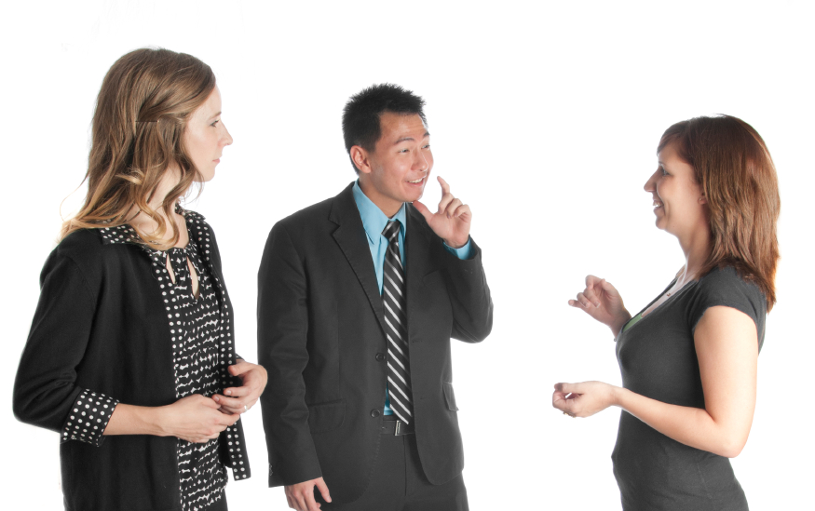
Standard 5
Offer communication and language assistance.

Slide 6
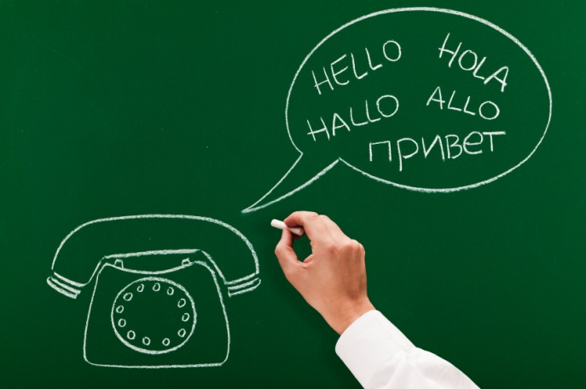
What is language assistance?
In-person interpreters
Bilingual staff
Remote interpreting systems
Telephone
Video
Translation of written materials, signs, web
Sign language
Braille materials, enhanced/large font
Voice-over recordings

Slide 7
Back

Slide 8
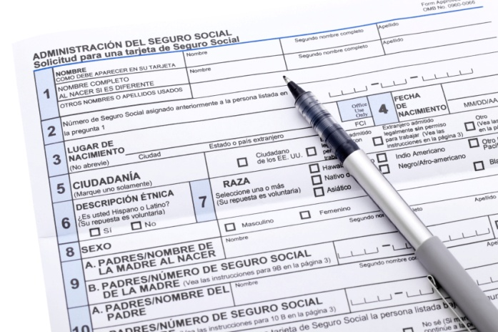
How to prioritize translations
Four-factor analysis for Vital Documents
The number and proportion of LEP individuals served.
The frequency of contact LEP individuals have with the program or service.
The nature and importance of the program.
The resources available.

Slide 9
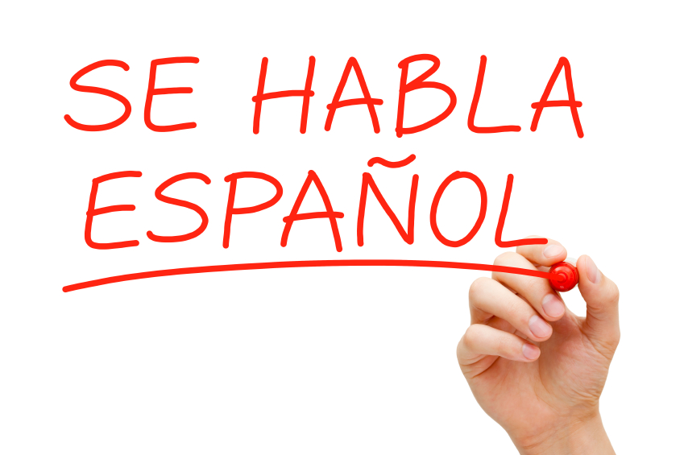
Standard 6
Inform individuals of the availability of language assistance.

Slide 10
Barriers to services
What do you think are two of the most commonly reported barriers that individuals with limited English proficiency experience?
Lack of availability of language services
Lack of awareness that such services exist

Slide 11
Case Study
The Lower Valley Medical Center serves a diverse population. About 30% of their patients speak Spanish, 10% speak Russian, and 5% speak Cambodian. The Center providers were having difficulty communicating important health information to their patients—often relying on the patient’s family member (usually a child) to interpret.
The providers approached their Executive Director for a solution. The Center signed a contract with a language line and hired a bi-lingual medical assistant (English/Spanish).
What can the center do to let their patients know that these language services exist?

Slide 12
Strategies for implementation
Determine the content and language of notices
Decide how to communicate or provide notice to individuals
Decide where to provide notice to individuals about the availability of assistance

Slide 13
What to write the notice
The communication should:
Clearly state that the language assistance is provided free of charge
Be easy to understand at a low literacy level
Include what assistance is available
In what languages?
Who are these services available for?

Slide 14
How to communicate the notice
Ways to inform individuals:
Signage, materials, multimedia
Cultural mediation
Community outreach
Initial point of contact
Non-English Media
Web
Phone message

Slide 15
Where to provide the notice
Places to consider:
Points of entry or intake
Front desks
Lobby, waiting area
Areas of service
Exam, meeting rooms
Common contact points
Web landing page
On-hold message

Slide 19
SMALL GROUP DISCUSSION: How will the Lower Valley Medical Center know their language assistance is effective?

Slide 20
Standard 7
Ensure the competence of individuals providing language assistance.

Slide 21
Bad translation example
English
Arabic
“It’s possible for me to eat eating fingers”
*Eating with left hand

Slide 22
Bad interpretation example
LARGE GROUP DISCUSSION:
When is competent interpretation most critical?
Which services in your organization are most critical?
Is it ever appropriate to use a child as an interpreter?

Slide 23
Ensuring competence helps
Provide accurate and effective communication
Reduce misunderstanding and dissatisfaction
Empower individuals to negotiate and advocate for important services
Help organizations comply with requirements

Slide 24
Skills and qualifications
Interpreters | Translators
Knowledge of subject area, relevant vocabulary
Active listening | Expert in written communication
Message conversion | Good research skills
Familiarity with regionalisms and slang | Intimate knowledge of native language
Can identify difference in meaning due to dialects | Able to write in idiomatic and natural patterns
Knows varying levels of formality | Continues education
Understands idioms | Knowledge of professional limits
Understands key concepts like informed consent | Can translate documents like informed consent forms

Slide 25
Assessing language ability
IRL | ACTFL | Simplified definition
5 | Native | Speaks like educated, native speaker
4+, 4 | Distinguished | Fluent, accurate, speaks idiomatically
3+, 3 | Superior | Sufficient structural accuracy and vocabulary for most conversations
2+ | Advanced Plus | Working language
2 | Advanced | Social language
1+ | Intermediate - High | Survival language
1 | Intermediate – Mid Intermediate – Low | Greetings
0+ | Novice - High | Learned utterances
0 | Novice – Mid Novice – Low | Very limited capacity – no ability

Slide 26
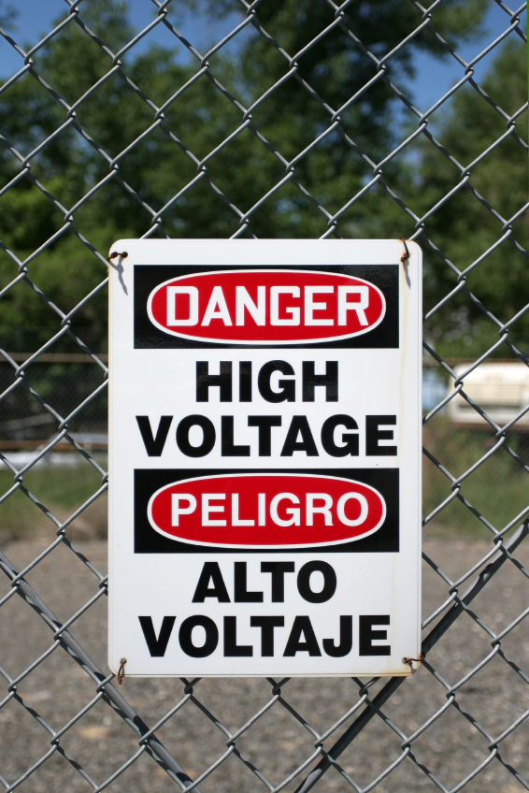
Standard 8
Provide easy-to-understand materials and signage.

Slide 27
Why its important
1/3 of adults have limited health literacy
Minority populations are disproportionality affected
Failure to address health literacy may further widen disparities

Slide 28
What do easy-to-understand materials look like?
User friendly design
Appropriate graphics
Focus on actionable information
Avoid jargon

Slide 29
Implementation strategies
Offer assistance
Interpretation, translation, alternative formats
Externally contracted, competent staff
Train staff
Recognition of need, how to operationalize tools
Create a shame-free environment
Engage your audience
Test materials you create for readability
Evaluate effectiveness of communications
Formalize internal processes
Issue plain talk guidance

Slide 30
Thank you!

