Slide 1
Session 4 Engagement, Continuous Improvement, and Accountability
CLAS Training [ADD DATE]
[ADD PRESENTER NAME] [ADD ORGANIZATION NAME]

Slide 2
Welcome
Review
Principal Standard: Provide effective, equitable, understandable, and respectful quality care and services that are responsive to diverse cultural health beliefs and practices, preferred languages, health literacy and other communication needs.

Slide 3
Learning objectives
List the steps in a quality improvement process.
Identify two ways to reduce barriers to data collection.
Explain how partnering with the community you serve can improve the effectiveness of your services.

Slide 4
Standard 9
Infuse CLAS goals, policies, and management accountability throughout the organization’s planning and operations.

Slide 5
Executive Director
Director of Health Programs
Program Planner
Program Evaluator
Operations Director
Office Manager
Admin. Asst.
Health Educator
Customer Service Rep.
Outreach Specialist
Finance Director
Accountant
Payroll Specialist
Contracts Manager
Data Collector
Human Resources Director
Workforce Dev. Coord.
Quality Improv. Manager

Slide 6
Executive Director
Director of Health Programs
Program Planner
Program Evaluator
Operations Director
Office Manager
Admin. Asst.
Health Educator
Customer Service Rep.
Outreach Specialist
Finance Director
Accountant
Payroll Specialist
Contracts Manager
Data Collector
Human Resources Director
Workforce Dev. Coord.
Quality Improv. Manager

Slide 7
Executive Director
Director of Health Programs
Program Planner
Program Evaluator
Operations Director
Office Manager
Admin. Asst.
Health Educator
Customer Service Rep.
Outreach Specialist
Finance Director
Accountant
Payroll Specialist
Contracts Manager
Data Collector
Human Resources Director
Workforce Dev. Coord.
Quality Improv. Manager
Notes:
CLAS should be a core element in the organization/agency’s operation principles, service focus, and quality improvement practices.

Slide 8
Executive Director
Director of Health Programs
Program Planner
Program Evaluator
Operations Director
Office Manager
Admin. Asst.
Health Educator
Customer Service Rep.
Outreach Specialist
Finance Director
Accountant
Payroll Specialist
Contracts Manager
Data Collector
Human Resources Director
Workforce Dev. Coord.
Quality Improv. Manager

Slide 9
Executive Director
Director of Health Programs
Program Planner
Program Evaluator
Operations Director
Office Manager
Admin. Asst.
Health Educator
Customer Service Rep.
Outreach Specialist
Finance Director
Accountant
Payroll Specialist
Contracts Manager
Data Collector
Human Resources Director
Workforce Dev. Coord.
Quality Improv. Manager

Slide 10
Executive Director
Director of Health Programs
Program Planner
Program Evaluator
Operations Director
Office Manager
Admin. Asst.
Health Educator
Customer Service Rep.
Outreach Specialist
Finance Director
Accountant
Payroll Specialist
Contracts Manager
Data Collector
Human Resources Director
Workforce Dev. Coord.
Quality Improv. Manager

Slide 11
Implementation Strategies
Allocate resources for CLAS implementation
Identify CLAS champions and empower them to advocate for CLAS
Review CLAS efforts and opportunities in staff retreats or meetings
Include your target population in strategic and operational planning

Slide 12
Standard 10
Conduct organizational assessments.

Slide 13
Quality improvement process
STEP 1: Organizational Assessment
STEP 2: Planning Phase
STEP 3: Implementation Phase
STEP 4: Evaluation Phase

Slide 14
Example evaluation measures
Accessibility of interpreter services
Effectiveness of cultural and linguistic competency training
Differences in the use of services among diverse populations
Impact of competent service provision on health outcomes and health status and on individuals’ satisfaction

Slide 15
Methods for evaluation
Provide individuals with feedback forms
Conduct focus groups to monitor progress
Assess standard of care
Add CLAS questions to staff reviews
Create ystem to review feedback
Identify metrics

Slide 16
Implementation Strategies
Use or adapt established organizational assessment tools
Identify opportunities for improvement
Plan improvement activities and metrics for evaluation
Choose a new quality improvement project each year

Slide 17
Standard 11
Collect and maintain demographic data.

Slide 18
Small group activity
Come up with five reasons why its important to collect and maintain demographic data.
What key elements should be collected?
How does your organization use demographic data to guide decisions?

Slide 19
Small group activity
What do you think about U.S. Department of Health and Human Services data collection standards?
What is missing?
What isn’t necessary?

Slide 20
Implementation Strategies
To reduce barriers
De-identify data or use codes
Clarify purpose of data
Specify staff that have data access
Train staff on client record confidentiality

Slide 21
Implementation Strategies
To gather data
Develop a script
Ask early
Respond to concerns
Allow individual self-report
Use standards collection instruments

Slide 22
Standard 12
Conduct assessments of community health assets and needs.

Slide 24
Community Services Assessment
Needs assessment
Gaps analysis
Resource Inventory

Slide 25
Implementation Strategies
Partner on data sharing, collection, analysis with other organizations
Conduct formative research
Review available demographic data
Use multiple sources in the community to collect data (e.g. faith based and manage care organizations)
Compare the trends in your data with your partner’s data

Slide 26
Standard 13
Partner with the community.

Slide 27
Higher trust and quality of services reported by community members
Community Engagement

Slide 28
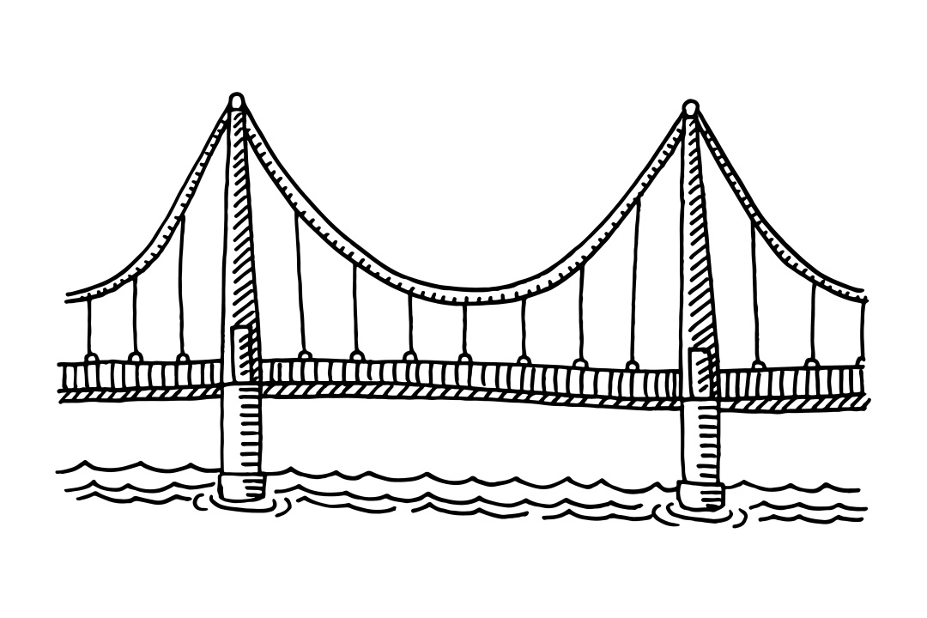
Cultural Brokers
People of different backgrounds
Organization or Agency

Slide 29
Community Health Workers

Slide 30
Stretch break. Find someone on the other side of the room:
How does your program partner with the communities you serve?

Slide 31
Implementation Strategies
Partner with culturally diverse media
Ensure coalitions, committees, and workgroups have community representation
Convene town hall meetings and community forums
Conduct focus groups
Hire community health workers and cultural brokers
Engage communities early, before decisions are made about programs or projects

Slide 32
Standard 14
Create conflict and grievance resolution processes.

Slide 33
The effect of unfair treatment
Discrimination
Race
Ethnicity
Sex
Age
Socioeconomic status
Sexual orientation
Gender identity
Disability
Impedes provisions of quality care and services

Slide 34
Lack of conflict and complaints
Satisfaction with services or care provided

Slide 35
Implementation Strategies
Provide training on cross-cultural communication and conflict resolution
Notify people of their right to file a complaint
Develop a clear process that is linguistically accessible
Provide options for verbal complaints to ensure people with limited literacy have a voice
Get feedback on your complaint processes

Slide 36
Standard 15
Communicate the organization’s progress in implementing and sustaining CLAS.

Slide 37
Example Scenario
Your city has a large Somali refugee community. Since resettling in the U.S., this community has struggled to access healthcare and other social services. They avoid going to health clinics because the healthcare staff do not speak Somali. When they get a prescription, they don’t fill it because they can’t understand how to take their medication correctly. Social service organizations give them brochures about programs like free child care, but they don’t understand how to sign-up.
Both the social service and healthcare organizations often ask Somali community leaders for their help translating materials or interpreting appointments for free. However, they have not listened when the Somali leaders have told them what their community needs to have better access to services.

Slide 38
No effort to improve linguistic accessibility
The Somali community’s experience
Community distrust
Efforts made to improve linguistic accessibility
No communication about efforts
The Somali community’s experience
Community distrust
Efforts made to improve linguistic accessibility
Organizations engage and tell community about efforts
The Somali community’s experience
Community trust starts to rebuild

Slide 39
What to share
Demographic data about the community you serve
How often people use your services
Your organization’s commitment to culturally and linguistically appropriate service, including staff training
Resources you’ve allocated towards CLAS
Results from assessments and evaluations
The number and type of complaints and how they’ve been resolved

Slide 40
Implementation Strategies
Distribute materials that demonstrate efforts
Discuss services and progress with community organizations
Create advisory boards
Engage community-based workers to craft and deliver messages
Convene educational forums

Slide 41
Thank you!

