Slide 1
Session 5 Integrating CLAS Into Policy and Practice
CLAS Training [ADD DATE]
[ADD PRESENTER NAME]
[ADD ORGANIZATION NAME]

Slide 2
Learning Objectives
Identify the staff needed to adopt and implement CLAS
Give examples of the important elements in a policy on CLAS standards
Identify one barrier and one approach to integrating CLAS into practice

Slide 3
Review of Previous Sessions
What did you learn?
Themes of the CLAS Standards
Governanace, Leadership and Workforce
Communication and Language Assistance
Engagement, Continuous Improvement and Accountability

Slide 4
Why Have a Policy?
Provides a framework
Give consistency and efficiency
Ensures compliance
Influences perception from community

Slide 5
Today’s Task
Integrating CLAS into Policy | Integrating CLAS into Practice
Umbrella policies | Grants
Existing policies | Organizational culture
New policies | Customer service
 | Material development

Slide 6
How does your Agency Develop Policies?
Every agency is different
DISCUSSION
What is your agency’s process for adopting and changing policies?
What is the process and timeline for reviewing and updating policies?
Who is typically involved?

Slide 7
CLAS Adoption Team
Example team roles
Executive Sponsor
Human Resources Coordinator
Data Coordinator
Communications Coordinator
Who else?
Staff engaged in effort, champions
Staff affected by CLAS but not in decision making roles
Gatekeepers
Decision makers

Slide 8
Adopting CLAS
1 | 2 | 3 | 4 | 5
1
Umbrella policy only
2
Integrate into existing policies only
3
Integrate into existing policies plus umbrella policy
4
Integrate into existing policies, develop new policies to address gaps
5
Integrate into existing policies, develop new policies to address gaps, plus umbrella policy
Most comprehensive approach

Slide 9
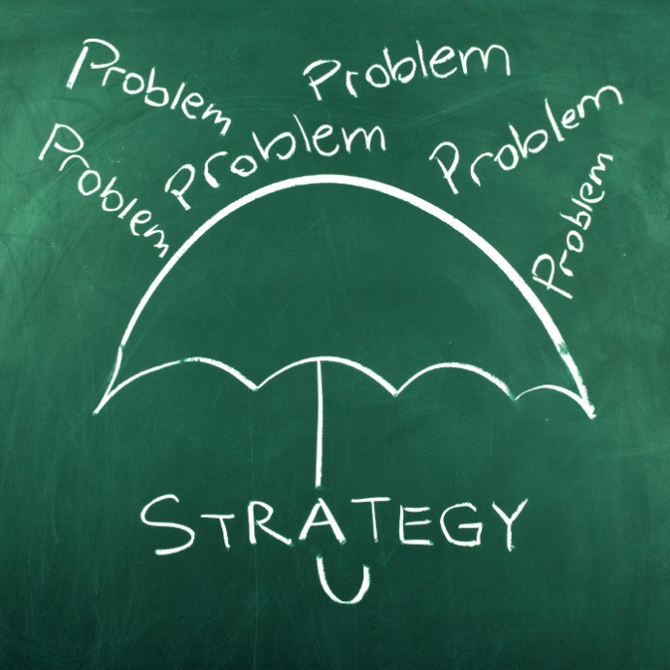
Umbrella Policy
Advantages
Large statement of compliance
Only one policy
Most efficient
Disadvantages
Less assurance
Work to understand CLAS falls on policy implementers

Slide 10
Integration
Advantages
Allows for more assurance
Can be gradual
Disadvantages
Gradual integration doesn’t provide foundation
Potential policy gaps—are all CLAS standards met through revised, existing policies?

Slide 11
Example Policy Review Process
Committee sends to policy owner
Policy owner reviews, makes any edits, and submits to committee
Internal policy committee identifies policies that are nearing review date
If revised, policy is sent for needed approvals
Revision is communicated to affected staff

Slide 12
Integrating CLAS
Committee sends policy to owner with CLAS check-list and draft language
Policy owner reviews, makes edits to include CLAS compliant language, and submits to committee
Committee identifies policies that are nearing review date AND are related to CLAS
CLAS policy team trains internal policy committee on CLAS standards
Policy revision is communicated to affected staff
Revised policy is sent for needed approvals

Slide 13
New Policies
Advantages
Assures all CLAS standards are met through policies
Disadvantages
Could be laborious than an umbrella policy
Involves more people

Slide 14
Typical Elements of a Policy
AGENCY Title Subject Authorizing sources Effective date
I. Purpose
This policy directs the agency to take reasonable steps to provide [agency] customers with effective, equitable understandable, and respectful quality care and services that are responsive to diverse cultural health beliefs and practices, preferred languages, health literacy, and other communication needs.
II. Scope
All [agency] services.
III. Definitions and common terms
Source language: The language from which translation occurs. [See HANDOUT 5A]
IV. Policy
Provision of services
Language assistance
Staff recruitment, retention, promotion and training
Staff responsibilities
Monitoring, engagement and accountability
Complaint procedure

Slide 15
Typical Elements of a Policy
V. References
U.S. Department of Health and Human Services (2013). Office of Minority Health, National Standards for Culturally and Linguistically Appropriate Services in Health and Health Care.
U.S. Department of Justice (2000). Federal Register, Executive Order 13166 – Improving Access to Services for Persons with Limited English Proficiency.
VI. Resources
American Translators Association, http://atanet.org/
U.S. Census Data 2010, http://www.census.gov/2010census/
Procedures
Key Function: Translation conduct for bilingual staff
Activity: Agency bilingual staff will follow the translator code of conduct at all times when providing translating services to agency customers.
Person(s) Involved: Appointing authorities or their designees, HR staff, Bilingual Translation Unit supervisor, certified bilingual staff.
PROCESS: Translation Services
Steps: 1 Activity or Event(s): Accurately convey the source language message in document translations… Person(s) Involved: Bilingual Translation Unit supervisor, certified bilingual staff.

Slide 16
Policy Revision Activity
SMALL GROUP ACTIVITY
How could you strengthen example policy A to be completely CLAS compliant?

Slide 17
Integrating CLAS into Practice
Integrating CLAS into Policy | Integrating CLAS into Practice
Umbrella policies | Grants
Existing policies | Organizational culture
New policies | Customer service
 | Material development

Slide 18
ACTIVITY
1. What would be your strategy to integrate CLAS into your topic?
2. What barriers do you anticipate facing?
3. What opportunities already exist to leverage?
4. Who would you engage in this process?
HANDOUT 5A: CLAS Implementation Strategies

Slide 19
Assess organization, community
Governance Leadership Workforce
Communication
Language Assistance
Engagement
Continuous Improvement
Accountability
Identify gaps, opportunities, strengths, weaknesses
COMMUNITY ENGAGEMENT
Identify strategies for implementation
COMMUNICATION
Train staff
Implement
Monitor progress
Evaluate and maintain efforts

Slide 20
Thank you! You have completed the entire CLAS Training!
Notes:
And with that, we have completed the last session of the CLAS training! Thank you all for your participation over these last two days. We look forward to hearing your feedback on the sessions—which is reminder to please complete the evaluation form before you leave. There are questions for both session 5 and a short, post-training evaluation. Please also remember to turn in your notes sheets, if you wrote down any questions or comments.
Please do not hesitate to contact me if you have any questions.
Thank you again!

